Slide 1
Wednesday, February 6, 2013
Agenda
No TISK or MM
HW Questions (9-2 & 9-3)
Lesson 9-4: Inscribed Angles
Homework: Complete Ch9 HW Packet 1
Have your homework out and be ready to discuss any questions you had.

Slide 2
§9-4 Inscribed Angles
Definition:
Inscribed Angle
  An angle with a vertex on the circle.
C
A
B

Slide 3
§9-4 Inscribed Angles
Theorem:
Measure of an Inscribed Angle
  If an angle is inscribed in a circle, then the measure of the angle equals one-half the measure of its intercepted arc.
C
A
B

Slide 4
Practice: Find the measure of the indicated arc or angle.
B
D
85⁰
A

Slide 5
Practice: Find the measure of the indicated arc or angle.
F
E
160⁰
H

Slide 6
Practice: Find the measure of the indicated arc or angle.
N
L
70⁰
J

Slide 7
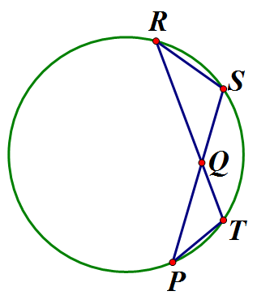
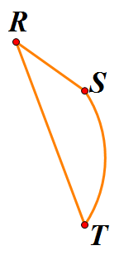
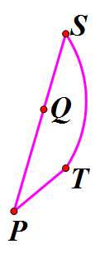

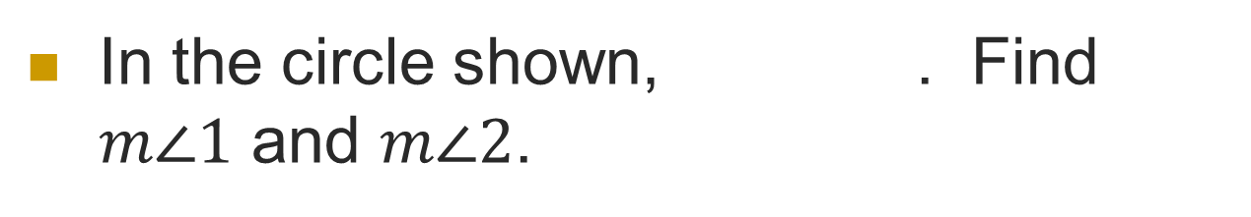




Example
In the circle shown, . Find $m∠1$ and $m∠2$.
$$m∠1=\frac{1}{2}m$$
1
$$m∠1=\frac{1}{2}(68°)$$
$$m∠1=34°$$
$$m∠2=\frac{1}{2}m$$
2
$$m∠2=34°$$

Slide 8
Theorem
Theorem:
If two inscribed angles of a circle (or of congruent circles) intercept the same arc (or congruent arcs), then the angles are congruent.
C
A
D
B

Slide 9
Inscribed Polygons
Definition:
  If all the vertices of a polygon are located on a circle, then it is inscribed in the circle.
  The circle is then circumscribed about the polygon.
D
A
C
B

Slide 10
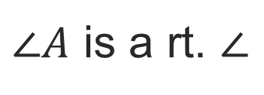
Inscribed Polygons
Theorem:
A right triangle is inscribed in a circle if and only if its hypotenuse is the diameter of the circle.
C
A
$∠A$ is a rt. $∠$
B

Slide 11
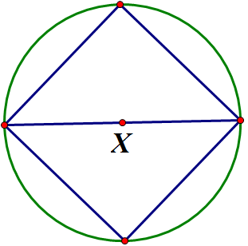
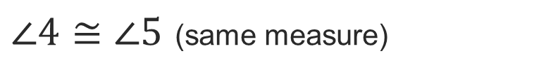
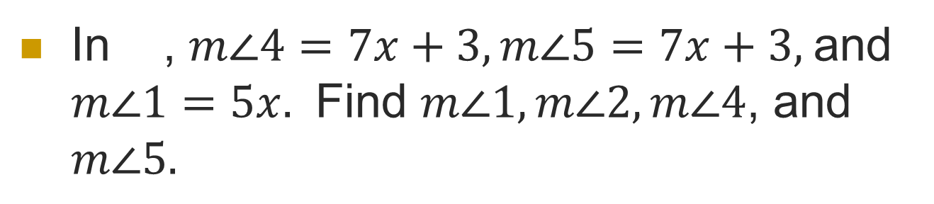
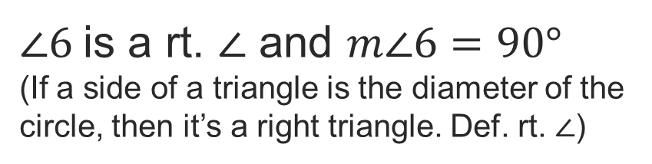
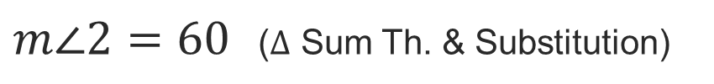
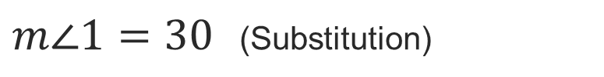
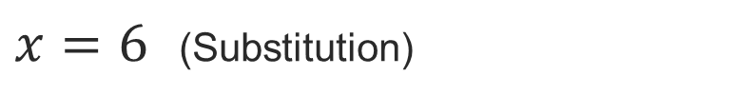
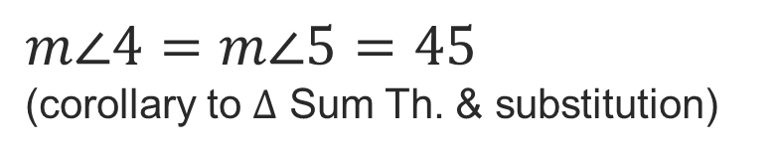
Example
In , $m∠4=7x+3, m∠5=7x+3,$and $m∠1=5x.$ Find $m∠1, m∠2, m∠4$, and $m∠5.$
$∠6$is a rt. $∠$ and $m∠6=90°$
(If a side of a triangle is the diameter of the circle, then it’s a right triangle. Def. rt. $∠$)
6
$∠4≅∠5$ (same measure)
$m∠4=m∠5=45$
(corollary to $Δ$ Sum Th. & substitution)
4
5
1
2
$x=6$ (Substitution)
$m∠1=30$ (Substitution)
3
$m∠2=60$ ($Δ$ Sum Th. & Substitution)

Slide 12
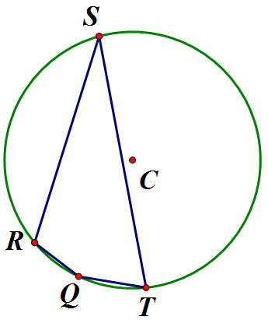
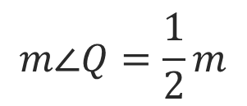
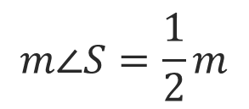




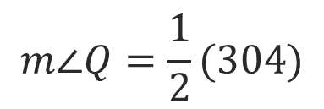
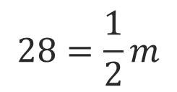

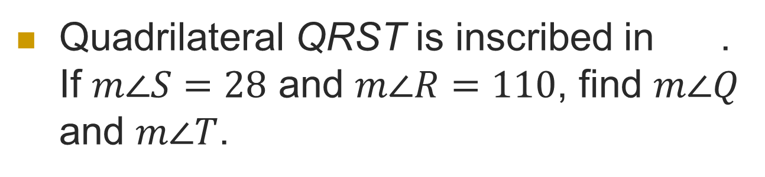
Example
Quadrilateral QRST is inscribed in . If $m∠S=28$ and $m∠R=110$, find $m∠Q$ and $m∠T$.
$$m∠S=\frac{1}{2}m$$
$$m =360−m$$
$$28=\frac{1}{2}m$$
$$m =360−56$$
$$m =304$$
$$56=m$$
$$m∠Q=\frac{1}{2}m$$
$$m∠Q=\frac{1}{2}(304)$$
$$m∠Q=152$$

Slide 13




Example
Quadrilateral QRST is inscribed in . If $m∠S=28$ and $m∠R=110$, find $m∠Q$ and $m∠T$.
$$m∠S+m∠R+m∠T+m∠Q=360$$
$$28+110+m∠T+152=360$$
$$m∠T+290=360$$
$$m∠T=70$$
$$m∠Q=152$$

Slide 14
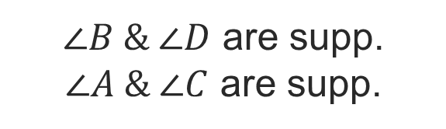
Theorem
A quadrilateral can be inscribed in a circle if and only if its opposite angles are supplementary
D
$∠B \& ∠D$ are supp.
$∠A \& ∠C$ are supp.
A
C
B

Slide 15
Practice. Find the value of each variable.
S
B
C
x⁰
T
y⁰
3x⁰
80⁰
85⁰
A
R
U

Slide 16
Practice. Find the value of each variable.
S
B
C
x⁰
T
y⁰
3x⁰
80⁰
85⁰
A
R
U

